Slide 1

VivesBank.Net

Slide 2




Slide 3





Slide 4

Bases De Datos

Slide 5




Slide 6


Slide 7

WebSocket

Slide 8







Slide 9
Dni
Nombre
Contraseña
Create Update

Slide 10
UserId
FullName
Adress
Photo
PhotoDni
AccountsIds
CreatedAt
UpdatedAt
IsDeleted

Slide 11
Id
Name
ProductType
Type(
BankAccount,
CreditCard)
CreatedAt
UpdatedAt
IsDeleted

Slide 12
ProductId
ClientId
TarjetaId
IBAN
Balance
AccountType
InterestRate
CreatedAt
UpdatedAt
IsDeleted

Slide 13
AccountId
CardNumber
Pin
Cvc
ExpirationDate
CreatedAt
UpdatedAt
IsDeleted

Slide 14
Id
ClienteGuid
Domiciliacion
IngresoDeNomina
PhotoDni
PagoConTarjeta
Transferencia
CreatedAt
UpdatedAt
IsDeleted

Slide 15
Explicación del proyecto.
💻

Slide 16
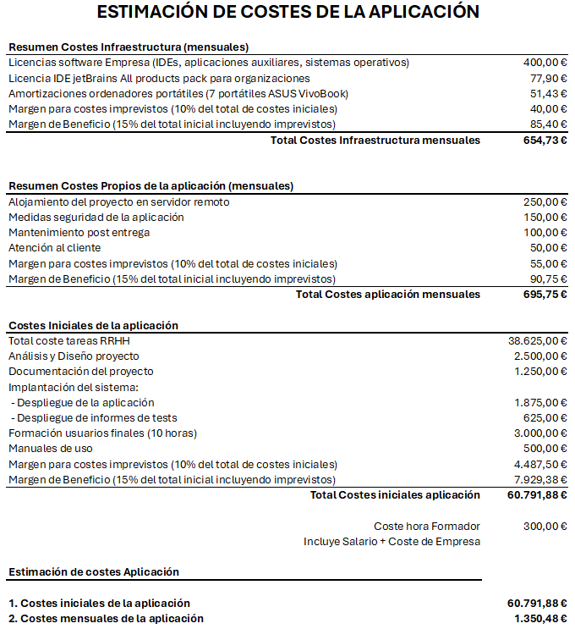

Costes

Slide 17







javierhvicente
samucese
rraul10
germangfc
tomasvaquerin
diegonovi
alvarito304

